Slide 1
Development Tools
WP2 T3

Slide 2





Learning Objectives
Recognize and use open file formats for producing FAIR learning objects
Use a version management system for versioning file contents
Select freely accessible software tools for working with various file formats
Operate an already created automated publishing workflow for processing any changes made to the learning materials
Explain the process of making changes to the learning objects and publishing them as a Git book

Slide 3
Agenda
File Formats and Markdown
Version Management with Git
Markdown Editing Environment
Working with Git Books

Slide 4

Introduction
Importance of careful selection of file formats
Both intermediary and final ones
Intermediary file format – targeted at content contributors
Final file format – ready for consumption by a wider audience
Interactive, visually appealing, accessible across various platforms
Importance of choosing the right set of tools
Image by Alexa from Pixabay

Slide 5

The Problem with Traditional Intermediary Formats
Traditional intermediary formats: .docx, .odt, Google Docs
Binary in nature
Difficult version control
-v1, -v2, -LATEST, -LATESTLATEST, -FINAL, -FINAL2, -FINALFINAL
No granular version control
Usually (but not always) requires using proprietary software tools or third-party cloud services
Accessibility, privacy issues
Solution?
Image by Christian Dorn from Pixabay

Slide 6

Hello, my name is… Markdown!
Image by sergeitokmakov from Pixabay
Plain-text based intermediary file format
Wide compatibility with version management systems
More on this in a bit…
Easy collaboration and change conflict resolution
Large ecosystem of accessible software tools
Editors, convertors, validators
Simple syntax for common formatting tasks
WYSIWYG editors available

Slide 7
Why Do I Have to Learn Yet Another Format?
Makes content reuse easier
Interoperability with many publishing platforms
Various final output formats: HTML, PDF
Widely used by other projects and initiatives; easy reusability
NASA’s Transform to Open Science, OpenSciency, FOSTER
Easy sharing and collaboration with third-parties
Public access to source files (if so desired)
Effortless version management
Extensive set of software tools
Accessible, no vendor lock-in
Automatic publishing as Git book
Easy findability via search engines (plain text…)

Slide 8
Final Words on Markdown
Focus on Markdown throughout the rest of the training
Alternatives are possible, but they are not the first choice for FAIR-by-Design learning objects
Drawbacks in terms of findability, accessibility, interoperability, and reusability
Slide decks are still made with traditional tools such as PowerPoint, Google Slides, LibreOffice Impress
Possible to use Markdown, but the ecosystem is not as mature yet

Slide 9
Version Management and Collaboration with Git

Slide 10
Git in a Nutshell
Most popular version management system today
Tracks file changes and versions over time
Possible to go back in time to previous versions
Record of who did what and when
Most powerful if used with plain-text files (e.g., Markdown)
Binary files are supported as well, but without granular change tracking (.docx, PowerPoint, PDF, images)
Cross platform, client applications available for all operating systems

Slide 11
Git Terminology (1)
Repository – a collaborative space where files can be versioned
Commit – granular record of change related to a single or multiple files placed in a single repository. Information about the author, time, and changes made
Clone – downloading an existing Git repository from an external source for local changes which can then be “committed”

Slide 12
Git Terminology (2)
Fork – 1:1 copy of an existing repository, resulting in the creation of a new repository. Both repositories have shared histories (all recorded commits up to the point of forking) but divergent futures.
Pull request/Merge request – way of reconciling changes made in a forked repository with the original one.
Each PR/MR consists of one or more commits
The owner of the fork submits a PR/MR to the original repository
The owner of the original repository reviews the changes and decides to accept or reject them

Slide 13

First Steps with Git
Before we start…
GitHub as a free Git repository hosting service
GitHub Desktop Client as a Git client for interacting with Git repositories
FAIR-by-Design Templates repository - https://github.com/FAIR-by-Design-Methodology/templates
Image by superintelligencek from Pixabay

Slide 14
Using GitHub – Organizations (1)
Difference between user owned repositories and organization owned repositories
Creating a new organization on GitHub
Navigating to the profile page
Selecting “New Organization”
Choosing the free plan
Filling out organization information (name, contact email)
Adding collaborators

Slide 15
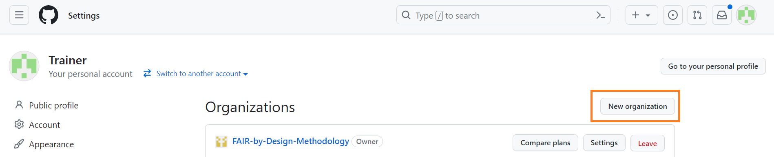
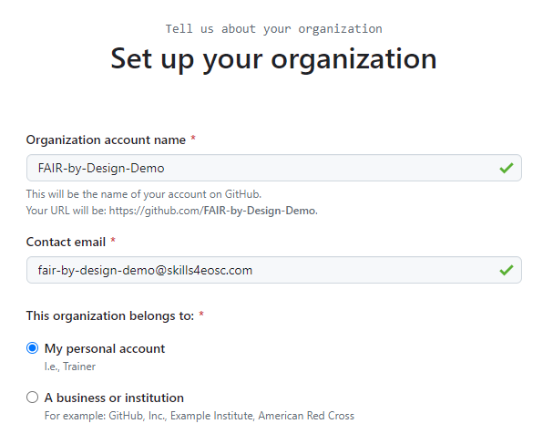
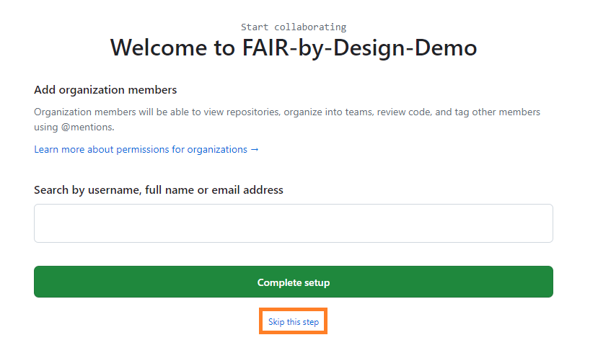
Using GitHub – Organizations (2)
1.
2.

Slide 16
Using GitHub – Forks (1)
Forking the FAIR-by-Design Learning Object Templates
https://github.com/FAIR-by-Design-Methodology/templates
Fork button
Fork owner: the newly created organization
Name: can be arbitrarily set, no limitations, no relation with the original name
Redirection to the homepage of the forked repository

Slide 17
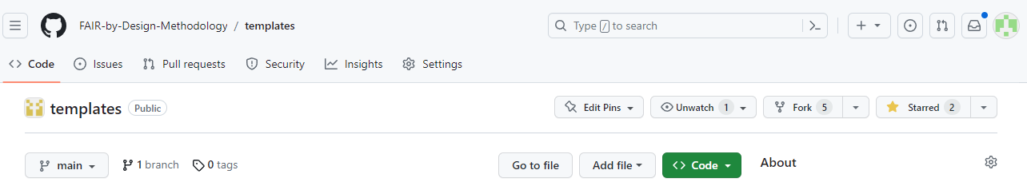
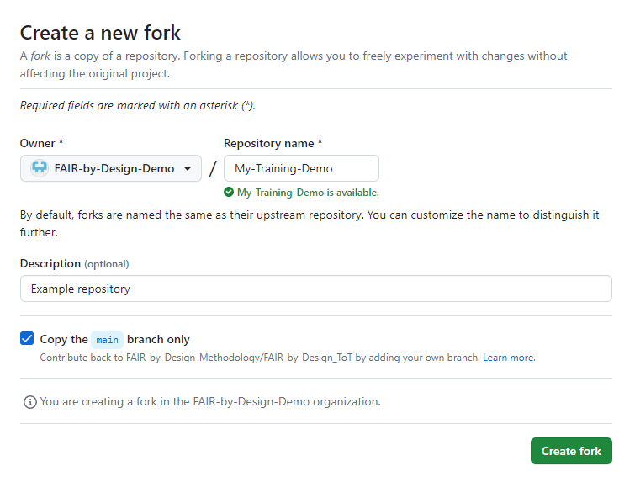
Using GitHub – Forks (2)

Slide 18
Using GitHub – Local Cloning (1)
Authentication with GitHub credentials in the GitHub Desktop Client
Setting profile information for commit metadata (name & email)
Selecting the new repository fork from the list of repositories
Choosing “For my own purposes” as a contribution method
Previewing the downloaded files

Slide 19
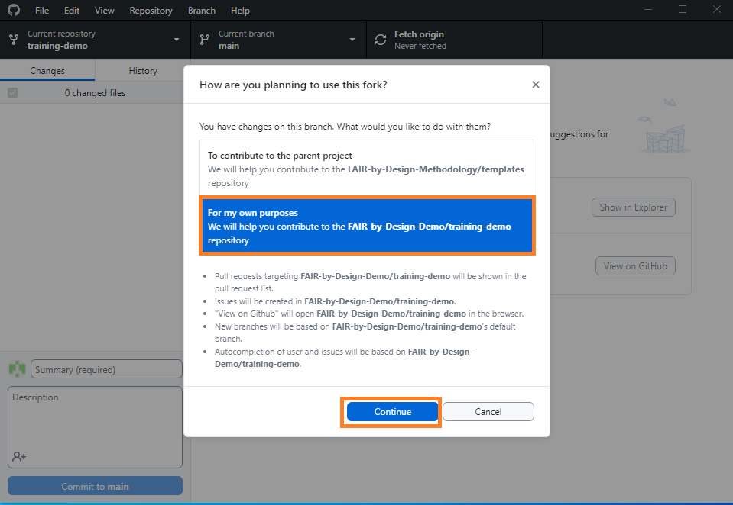
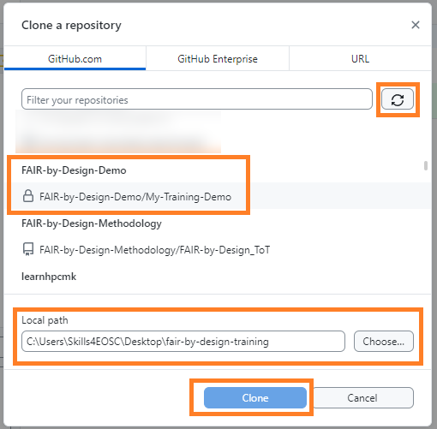
Using GitHub – Local Cloning (2)

Slide 20
Exercise: Using Git in Practice
To simulate the preparation of FAIR-by-Design learning objects, create a fork of the FAIR-by-Design Learning Object Templates repository, and then clone it locally as to continue working on the materials.
Tip: Use a GitHub organization as the owner of the fork and use the GitHub Desktop Client for cloning it locally

Slide 21
Setting Up a Markdown Environment

Slide 22
General Information on Markdown Editors
Any text editor can be seen as a Markdown editor
Yes, even Notepad
More advanced editors bring quality of life improvements
Better graphical user interface
Integration with external tools
Extensibility via addons
Markdown editor examples: Obsidian, VSCode, Zettlr, Joplin…
Focus on Obsidian in this training

Slide 23
Obsidian as a Markdown Editor
Free to use, cross-platform software
First-party and third-party plugins for added functionality
Vault – a folder opened in Obsidian
In our case vault is equivalent to a Git repository, 1:1 mapping
All settings are valid only for the currently open vault
Flexible approach, allows different configuration when working on different projects

Slide 24
Using Obsidian – First Steps (1)
The first launch wizard offers to open an existing folder as vault
Selecting the previously cloned repository
Two main areas within Obsidian
Navigation tree (to the left)
Editor (to the right)
Changing preview modes in Obsidian
Render Markdown on the fly
Show only Markdown source
Preview only rendered content (no edits)

Slide 25
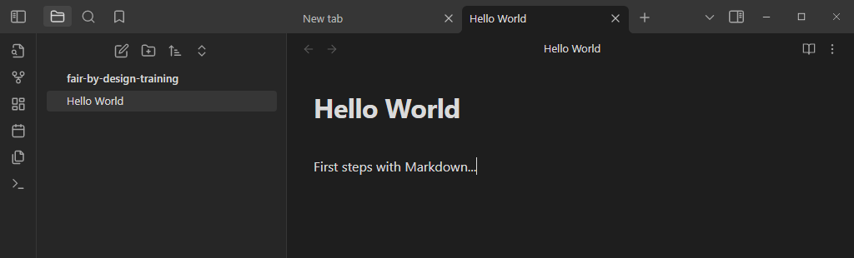
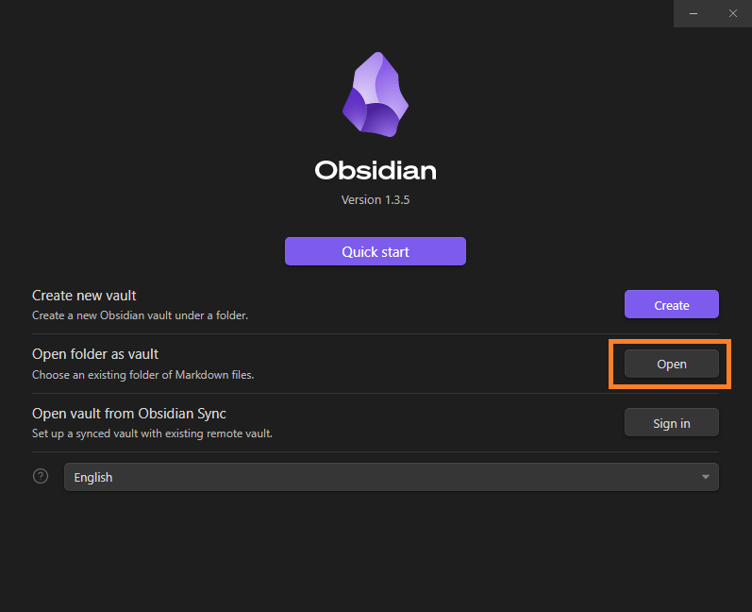
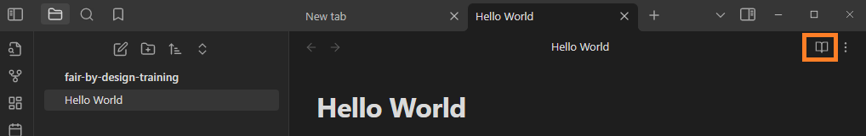
Using Obsidian – First Steps (2)
1.
2.

Slide 26
Using Obsidian – Changing Defaults (1)
No editing toolbar by default with common operations
Bold, italic, headings, bullets, lists
Using the vast ecosystem of plugins to overcome shortcoming
Plugin: Editing Toolbar
Plugin: Table Editor
Settings to be changed (Files & Links section)
Default location for new attachments -> In subfolder under current folder
Subfolder name -> attachments

Slide 27
Using Obsidian – Changing Defaults (2)
Settings to be changed (cont.)
New link format -> Relative path to file
Use [[Wikilinks]] -> Disable
Detect all file extensions -> Enable
Testing the changes
Copy/Paste an image in an arbitrary file
The image should appear automatically
The file will be placed in an “attachments” subfolder

Slide 28
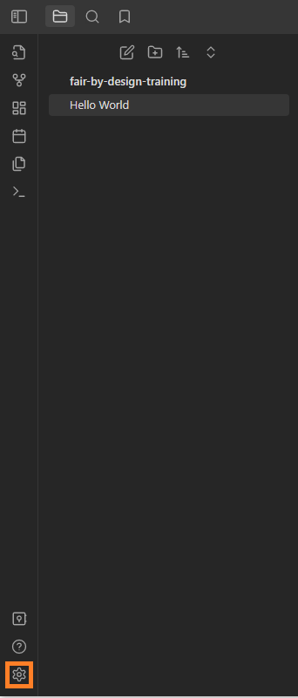
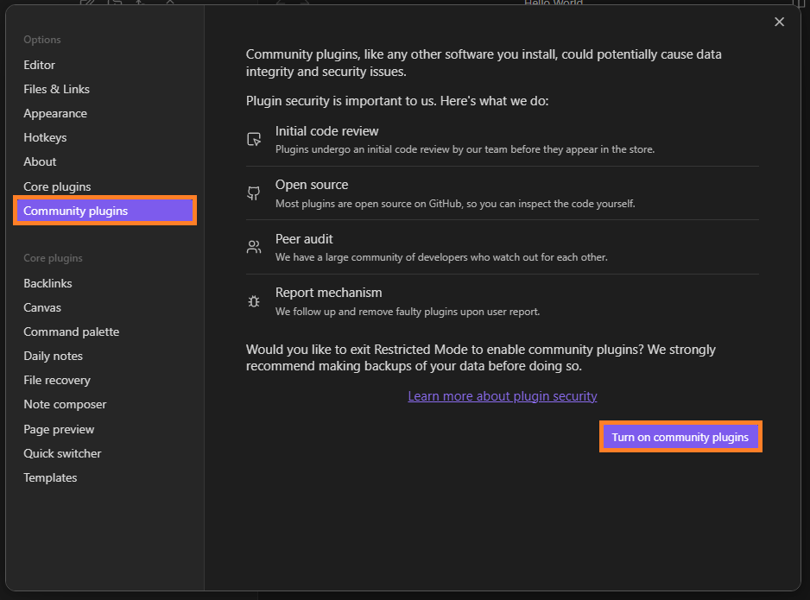
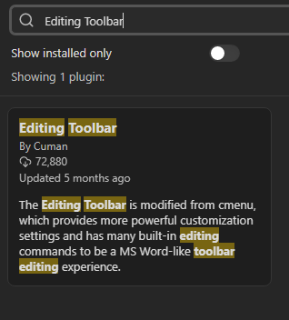
Using Obsidian – Changing Defaults (3)
2.
1.

Slide 29
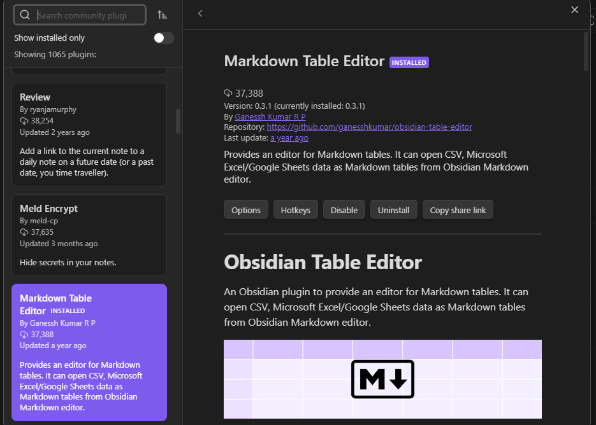
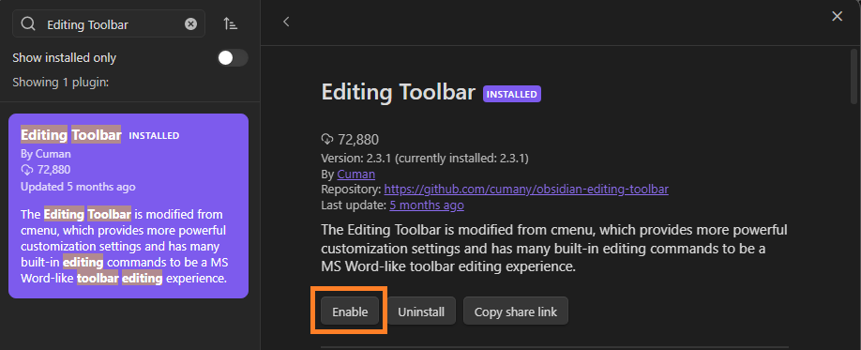
Using Obsidian – Changing Defaults (4)

Slide 30
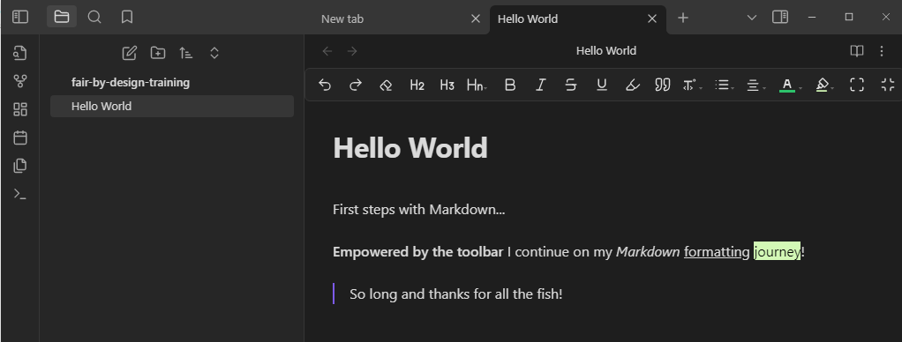
Using Obsidian – Changing Defaults (5)

Slide 31
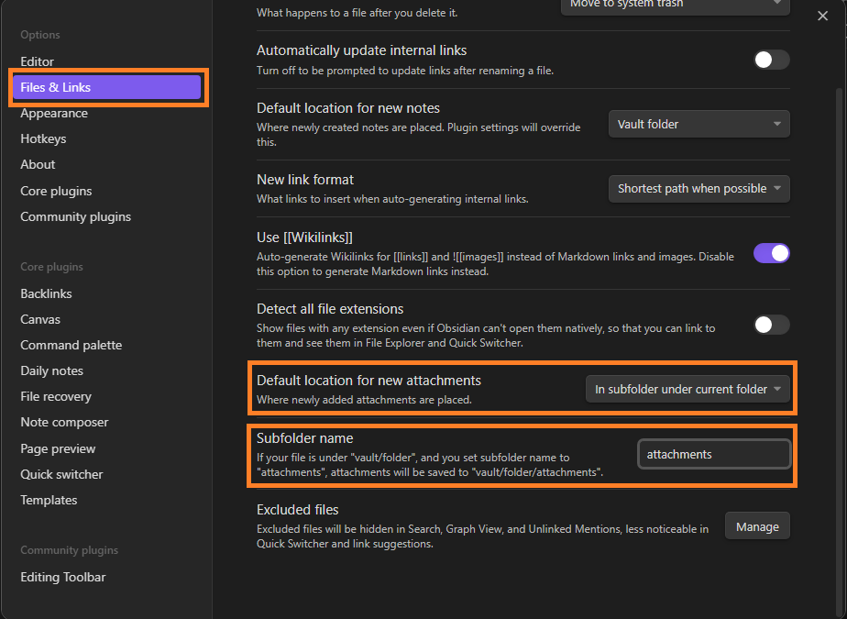
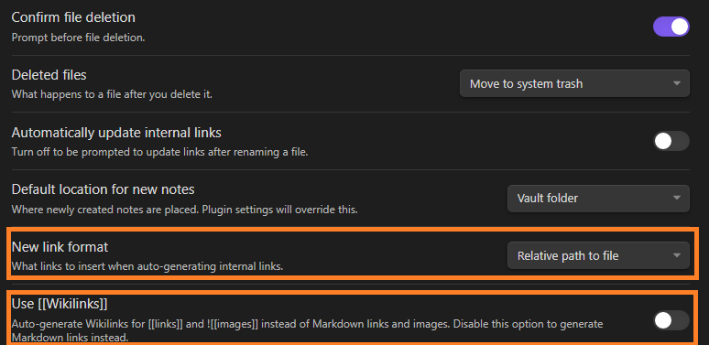
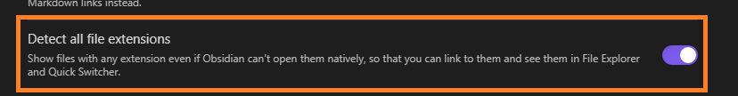
Using Obsidian – Changing Defaults (6)

Slide 32
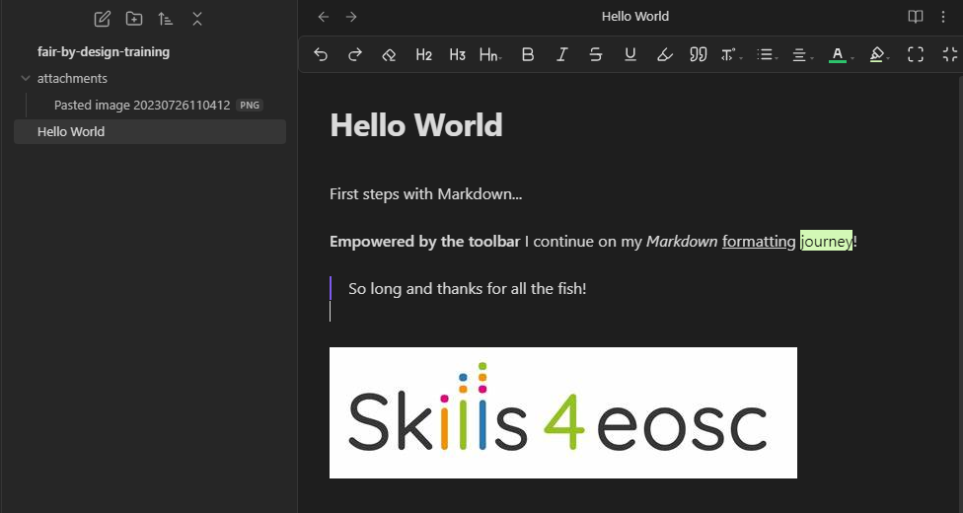
Using Obsidian – Changing Defaults (7)

Slide 33
Exercise: Configuring Obsidian
Go over the Obsidian setup process for the cloned repository, downloading the necessary plugins, and making the appropriate changes to Obsidian’s default behavior.

Slide 34
Working with Git books

Slide 35
Introduction to Git Books
Goal #1: Automatic conversion of Markdown documents to logically connected HTML files which would be publicly available
Goal #2: set-it-and-forget-it configuration
Many Git book frameworks
The training focuses on MkDocs
The templates repository already includes automatic workflows for publishing learning materials as a Git book

Slide 36

Configuring the Repository for Git Book Publishing
To do (only once per repository):
Enabling the “inherited” automatic workflows from the parent repository
Allowing the automatic workflows to make changes to the files in the repository
Enabling free hosting of the Git book on GitHub
Image by Gerd Altmann from Pixabay

Slide 37
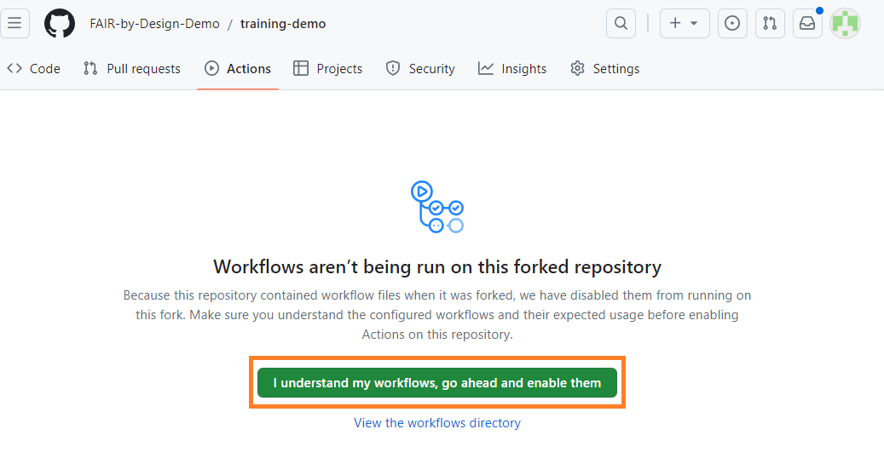
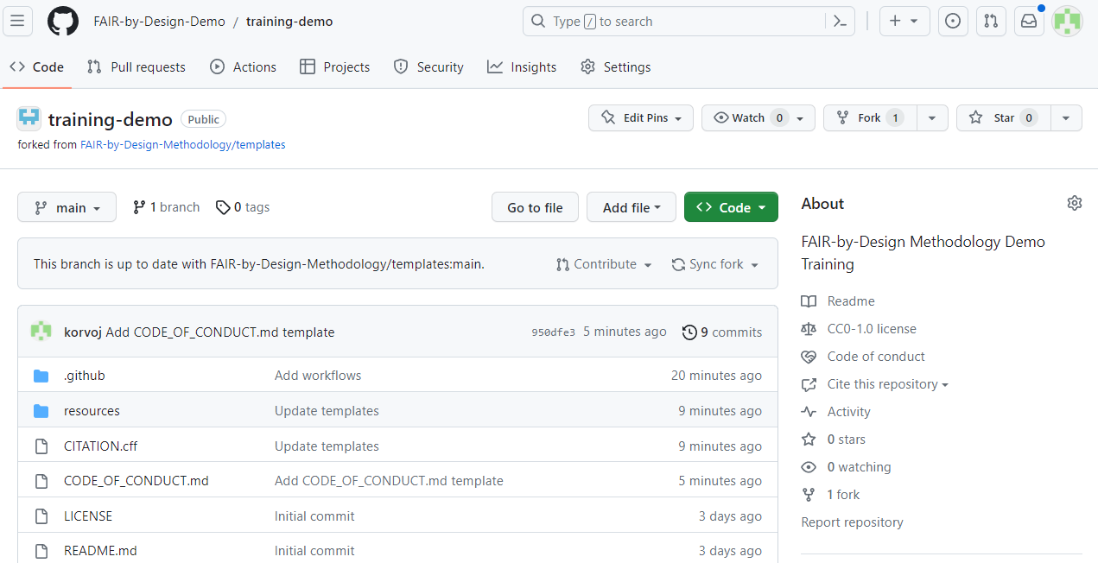
Enabling the GitHub Automatic Workflows

Slide 38
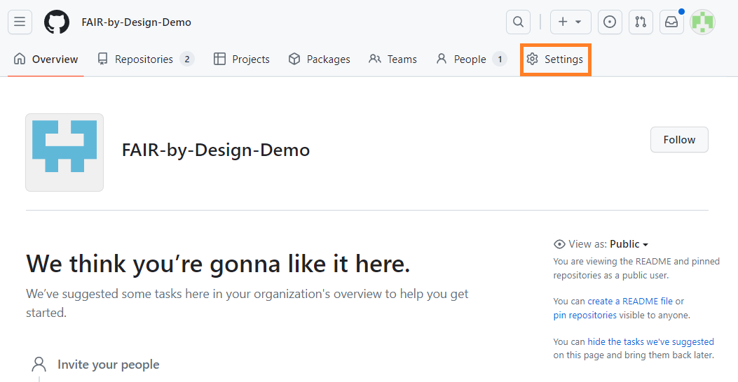
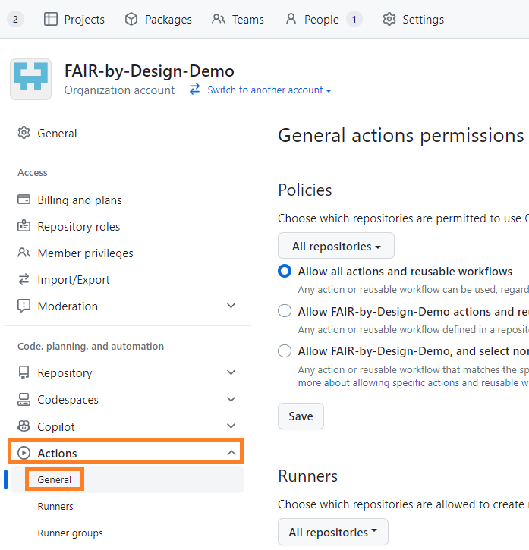
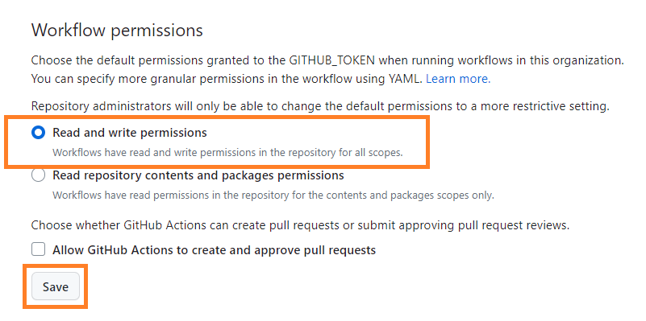
Allowing Changes by the Workflows
1.
2.

Slide 39
Previewing the Changes
The Git book publishing workflows are automatically launched upon every commit that changes an .md file in the resources folder
To try things out, we will make an arbitrary change to the syllabus, commit it, and push the changes using GitHub Desktop
We will track the workflow’s progress using the GitHub web interface

Slide 40
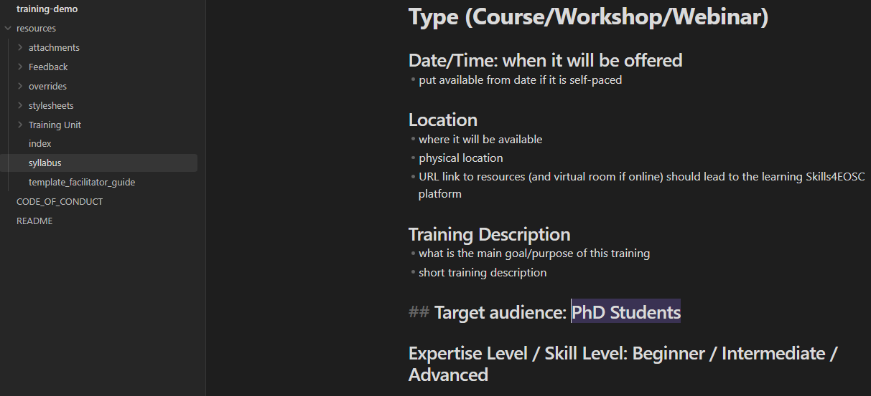
Making an Arbitrary Change

Slide 41
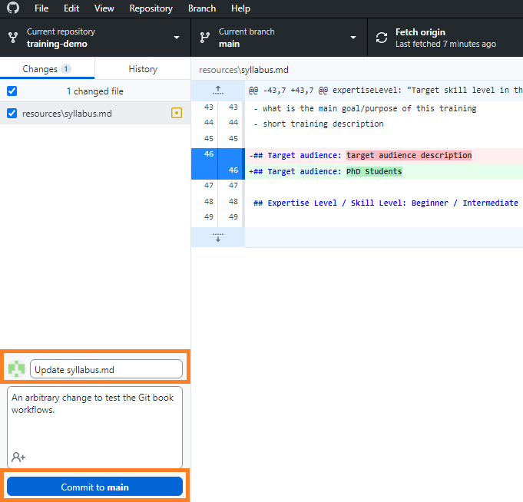
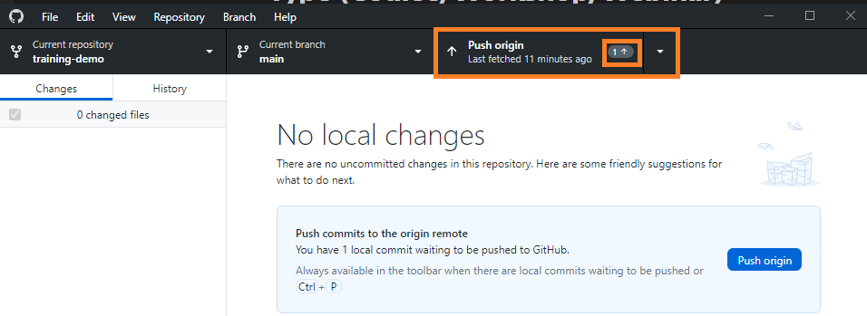
Committing the Changes

Slide 42
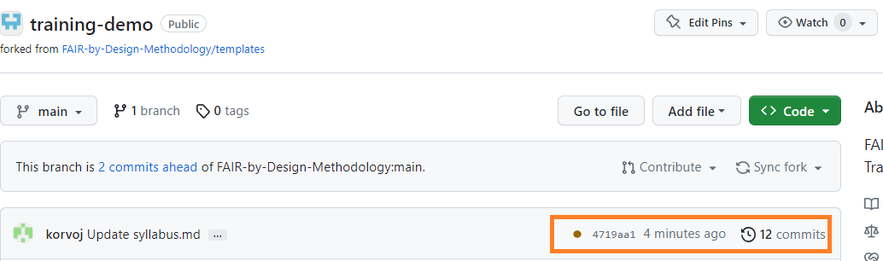
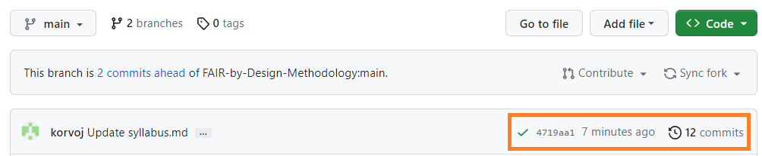
Tracking the Workflow’s Progress

Slide 43
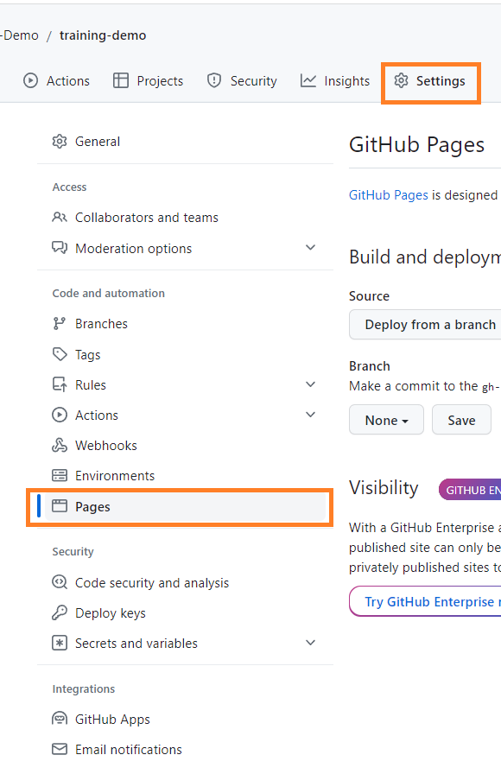
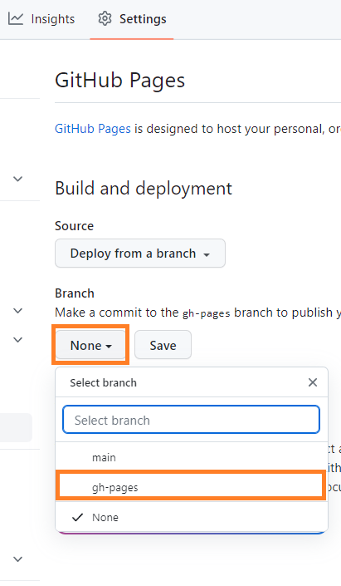
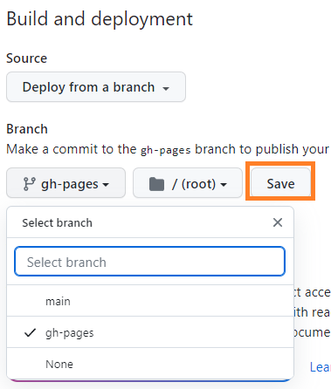
Enabling Free Hosting of the Git Book
These actions need to be performed only once per Git repository

Slide 44
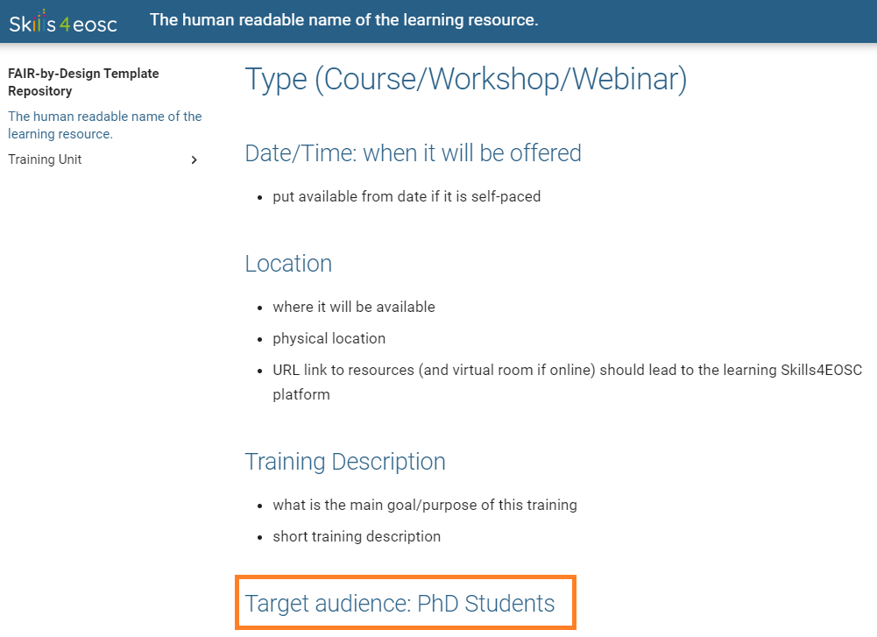
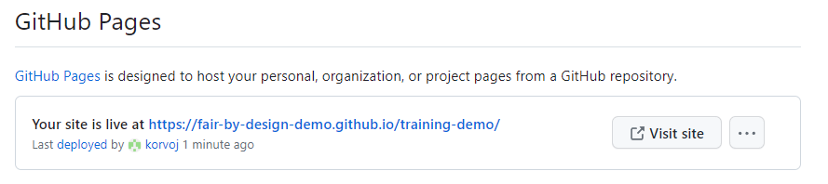
Previewing the Git Book

Slide 45
Exercise: Publishing Your Very Own Git Book
Prepare the forked repository for Git book publishing by following the previously outlined steps.
Make an arbitrary change to an .md file in the forked templates repository.
Push the changes and verify that the Git book has been successfully published.

Slide 46
Conclusion & Key Takeaways

Slide 47

Summary
Markdown as an intermediary file format for FAIR-by-Design learning resources
Git as a robust version management system facilitating collaboration and change tracking
Obsidian as an extensible Markdown editor allowing easy modification of template documents
Git book as one of the final file formats for the Markdown files
Image by Andy H from Pixabay

Slide 48
Thank you! Any questions before we continue?
vojdan.kjorveziroski@finki.ukim.mk
Cite instructions on: https://doi.org/10.5281/zenodo.10014781

